Slide 1
Ellis Island Immigration Simulation
-Imagine you are your assigned immigrant-Identify your name, age and occupation
Reveal your hopes, fears and emotions about coming to America and leaving your family. What potential obstacles might you face in coming to America (use the card to help you)???

Slide 2
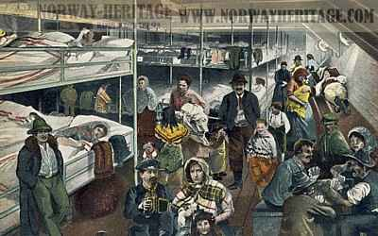
" During these twelve days In the steerage I lived In a disorder and in surroundings that offended every sense. Only the fresh breeze from the sea overcame the sickening odors. The vile language of the men, the screams of the women defending themselves, the crying of children, wretched because of their surroundings, and practically every sound that reached the ears Irritated beyond endurance. There was no night before which the eye did not prefer to close.
"Everything was dirty, sticky, and disagreeable to the touch. Every impression was offensive. Worse than this was the general air of immorality. For fifteen hours each day 1 witnessed all around me this Improper, indecent, and forced mingling of men and women who were total strangers, and often did not understand one word of the same language. People cannot live with such surroundings and not be influenced."

Slide 3
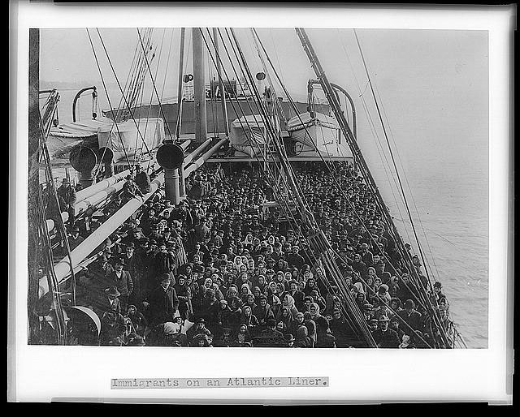

Slide 4
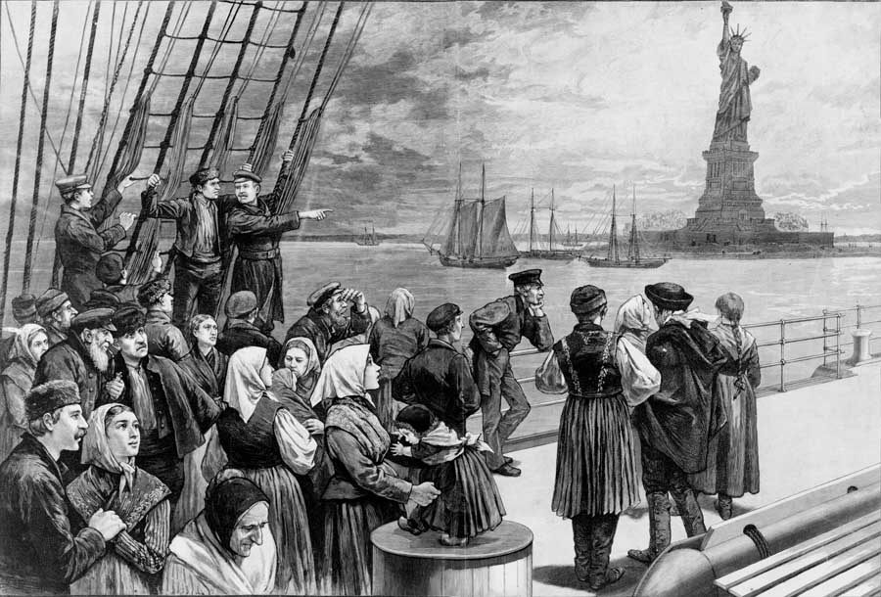
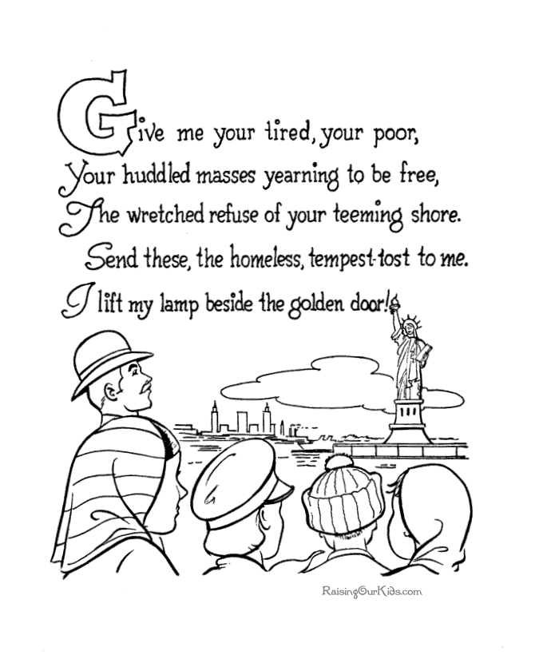

Slide 5
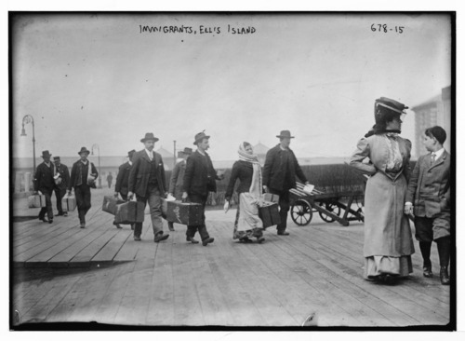
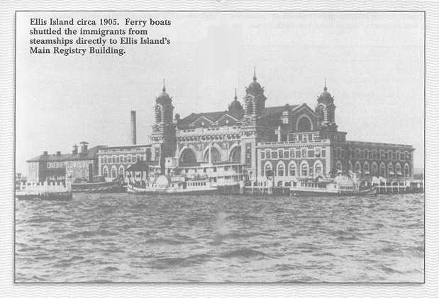

Slide 6
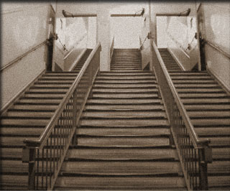
The first test the immigrants had to pass became known as the "six second medical exam." As the immigrants climbed the stairs to the Great Hall, doctors stood at the top and watched. They were looking for anyone having difficulty coming up the steps. If a medical problem or disability was suspected, one of seventeen different chalk marks was put on the person's clothing. They were then sent for a full physical examination. If they weren't marked, they went on to wait in the Great Hall to be processed and then exited down the Staircase of Separation (shown above) when they were finished.

Slide 7
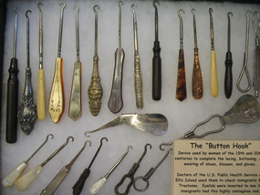
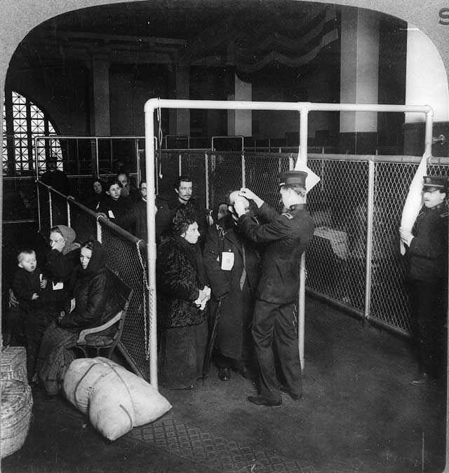
Eye Exam

Slide 8
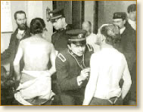
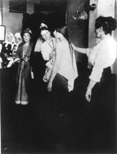
Medical Check: Eyes, scalp, heart rate

Slide 9
X | Suspected Mental Defect
Circled X | Definite signs of Mental Defect
B | Black
C | Conjunctivitis
CT | Trachoma
E | Eyes
F | Face
FT | Feet
G | Goiter
H | Heart
K | Hernia
N | Neck
L | Lameness
P | Physical and Lungs
PG | Pregnancy
SC | Scalp (Fungus)
S | Senility
SI | Special Inquiry

Slide 10
Medical Questions
Predict the conditions and reasons for some immigrants being denied entrance into the United States

Slide 11
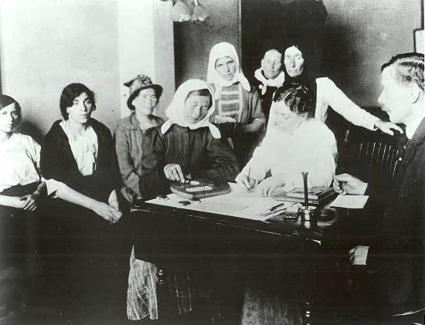
Mental exam

Slide 12
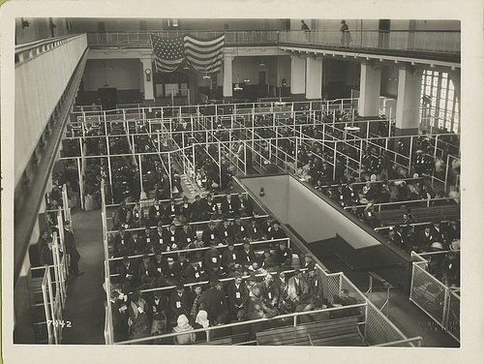
Legal Exam: “The Great Room.”
1. What is your name?
2. What is your age?
3. What is your sex?
4. Are you married?
5. What is your occupation?
6. Can you read? Write?
7. What is your nationality?
8. What city are you from?
9. Where are you going?
10. Who paid for your passage?
11. How much money do you have?
12. Have you ever been to the U.S.?
After passing the medical exams, immigrants had to prove they could legally come into America. They had to prove their country of origin and where they expected to live and work once they entered the country. Inspectors rejected any immigrant with a criminal record or those suspected of being indentured servants. By 1921, immigrants had to pass a literacy test and show a passport and visa.

Slide 13
Legal Exam
Why do you think these questions were asked?
What might the officials have been looking for?

Slide 14
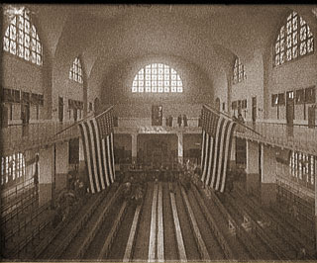
The Great Hall was the large waiting room of Ellis Island. Immigrants waited here for their interviews with legal inspectors after finishing their medical exams. At best, the entire process through Ellis Island took three to five hours. But sometimes problems came up, like family members waiting for a relative to be treated in the hospital ward. Some families stayed for days on Ellis Island, others for weeks, and still others for months.

Slide 15
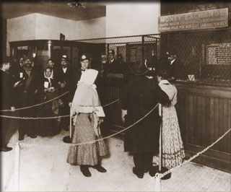
In the money exchange area immigrants exchanged the money of their homeland for dollars, and purchased any train tickets they needed. Laws passed in 1909 required each immigrant to have at least 20 dollars before they were allowed to enter America.

Slide 16
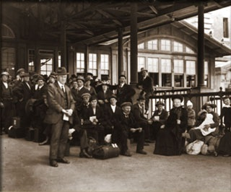
Just beyond the money exchange was the exit from Ellis Island. Staff members referred to this spot as the kissing post because of all the emotional reunions that were witnessed there. Two thirds of the new Americans then boarded a ferry to New Jersey, where the next leg of their American journey would begin. The remaining third took the ferryboat to Manhattan to begin their new life in New York City, only one mile away.

